Slide 1

A Multimodal BiMamba Network with Test-Time Adaptation for Emotion Recognition Based on Physiological Signals
Ziyu Jia^{1,2}, Tingyu Du^{3,4}, Zhengyu Tian⁵, Hongkai Li⁵, Yong Zhang⁶, Chenyu Liu⁷
¹Institute of Automation, Chinese Academy of Sciences
²Shanghai Key Laboratory of Data Science
³Beijing Key Laboratory of Mobile Computing and Pervasive Devices, Institute of Computing Technology, Chinese Academy of Sciences
⁴University of Chinese Academy of Sciences
⁵School of Computer Science and Technology, Beijing Jiaotong University
⁶School of Information Engineering, Huzhou University
⁷School of Computing and Data Science, Nanyang Technological University
Notes:
首页
Hello everyone, thank you for watching this video. I am very happy to share our work online.
大家好，感谢观看本视频。我很高兴能与大家分享我们的工作成果。

Slide 2
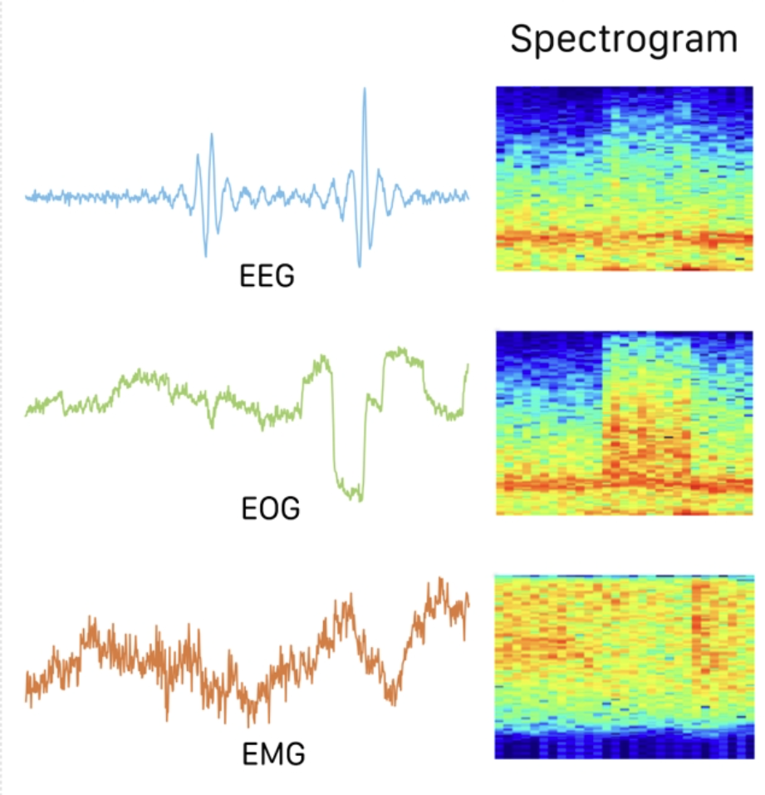
Introduction
Emotion Recognition based on Physiological Signals
Physiological signals reflect the true emotional state of the human body objectively.
Emotion recognition based on multimodal physiological signals provides a more comprehensive emotional assessment.
NeurIPS 2025
Notes:
Emotion recognition based on physiological signals plays a vital role in psychological health and human–computer interaction. In recent years, data sources for emotion recognition research have mainly focused on two aspects: non-physiological signals and physiological signals. Non-physiological signals, such as audio and video, are affected by subjective bias and intentional concealment. This makes it difficult for non-physiological signals to represent the emotional state of the body reliably. In contrast, physiological signals, such as electroencephalography (EEG) and electrooculography (EOG), reflect the true emotional state of the human body objectively. Therefore, emotion recognition based on physiological signals demonstrates great application potential in fields related to mental health.
Moreover, compared to unimodal physiological signals, emotion recognition based on multimodal physiological signals combines information from multiple sources to provide a more comprehensive emotional assessment.
基于生理信号的情感识别技术在心理健康和人机交互领域具有重要应用价值。近年来，情感识别研究的数据来源主要集中在两大方向：非生理信号与生理信号。非生理信号（如音频、视频）容易受到主观偏见和刻意隐瞒的影响，难以准确反映人体真实情绪状态。相比之下，生理信号（如脑电图EEG和眼电图EOG）能客观呈现人体真实情绪状态。因此，基于生理信号的情感识别技术在心理健康相关领域展现出广阔的应用前景。此外，相较于单一模式的生理信号，基于多模态生理信号的情感识别技术通过整合多源信息，能够提供更全面的情感评估。

Slide 3
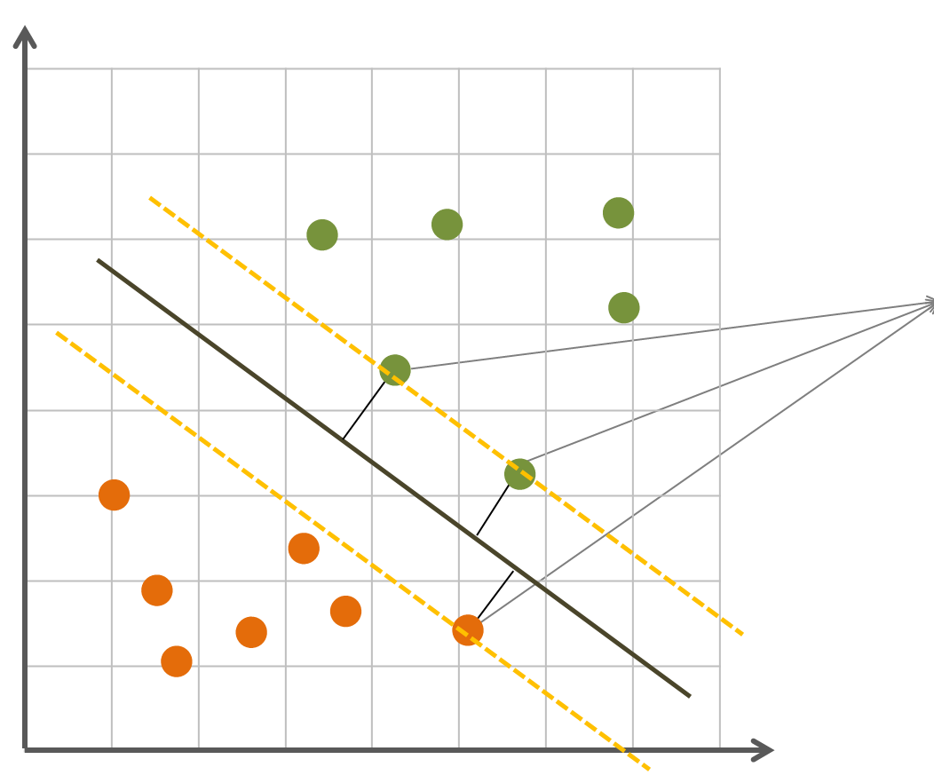
Related Work
Emotion recognition
· Traditional machine learning methods:
Support Vector Machine
They rely heavily on expert knowledge, are limited by feature design and selection.
support vector
· Deep learning methods:
Unimodal：SST-EmotionNet, TSception
Multimodal：the residual LSTM network, the Neurophysiological Transformer, GJFusion, etc.
Existing emotion recognition methods rely on traditional backbones, which struggle to model long-range dependencies and inter-modal correlations, and rarely address missing modality issues.
NeurIPS 2025
Notes:
In recent years, physiological signals have become a key focus in emotion recognition due to their ability to accurately and objectively reflect the genuine emotions of subjects. For instance,Bazgir et al. enhanced the accuracy by applying a cross-validated SVM with a radial basis function kernel for classification. However, traditional machine learning methods, which often rely heavily on expert knowledge, are limited by feature design and selection.
To overcome these limitations, researchers have applied deep learning methods to emotion recognition tasks. For example, in unimodal emotion recognition,Jia et al. proposed SST-EmotionNet, an attention-based 3D dense network that simultaneously integrates spatial-spectral-temporal features within a unified framework.Ding et al. designed TSception, a multi-scale convolutional neural network that extract temporal dynamics and spatial asymmetry features from EEG signals. These deep learning methods achieve remarkable results in the unimodal domain.
Moreover, studies have shown that multimodal methods can better capture the diversity and complexity of emotions, resulting in superior performance in emotion recognition. For instance,Ma et al. developed a multimodal residual LSTM network, sharing weights across modalities. Koorathota et al. proposed the Multimodal Neurophysiological Transformer, which employs cross-modal attention to capture inter-modal correlations. Huang et al. introduced GJFusion to address modality heterogeneity through channel-level inter-modality correlations based on graph joints.
Despite achieving promising performance, existing methods in multimodal emotion recognition primarily rely on traditional backbone networks, posing limitations in modeling long-range dependencies and inter-modal correlations of multimodal physiological signals related to emotion. In addition, these methods rarely address the issue of missing multimodal data.
近年来，生理信号因其能精准客观地反映受试者真实情绪而成为情感识别领域的研究重点。例如，巴兹吉尔等人通过采用带有径向基函数核的交叉验证SVM算法进行分类，显著提升了识别精度。然而，传统机器学习方法往往过度依赖专家知识，其特征设计与选择存在局限性。为突破这些瓶颈，研究者开始将深度学习方法应用于情感识别任务。在单模态情感识别领域，贾等人提出的SST-EmotionNet基于注意力机制构建的三维密集网络，实现了时空频特征的统一整合。丁等人开发的TSception多尺度卷积神经网络，能从脑电信号中提取时序动态与空间不对称特征。这些深度学习方法在单模态领域取得了显著成果。研究表明，多模态方法能更全面捕捉情绪的多样性和复杂性，从而在情感识别中表现更优。例如，马等人开发的跨模态残差LSTM网络实现了跨模态权重共享；库拉托塔等人提出的多模态神经生理变换器，通过跨模态注意力机制捕捉跨模态关联。黄等人提出GJFusion方法，通过基于图连接的通道级跨模态相关性来解决模态异质性问题。尽管该方法取得了显著成效，但现有多模态情感识别技术仍主要依赖传统骨干网络，这在建模情感相关的生理信号长距离依赖关系和跨模态关联性方面存在局限。此外，这些方法鲜少关注多模态数据缺失的问题。

Slide 4
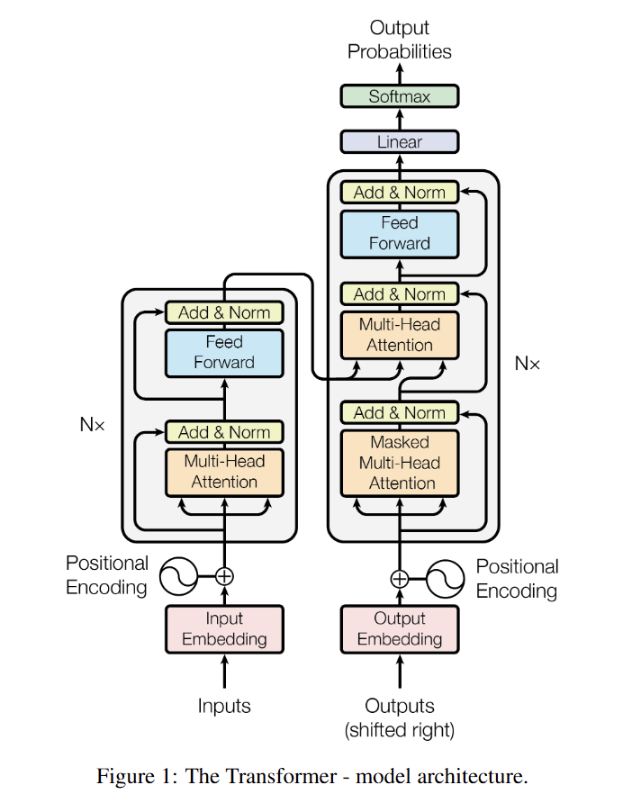
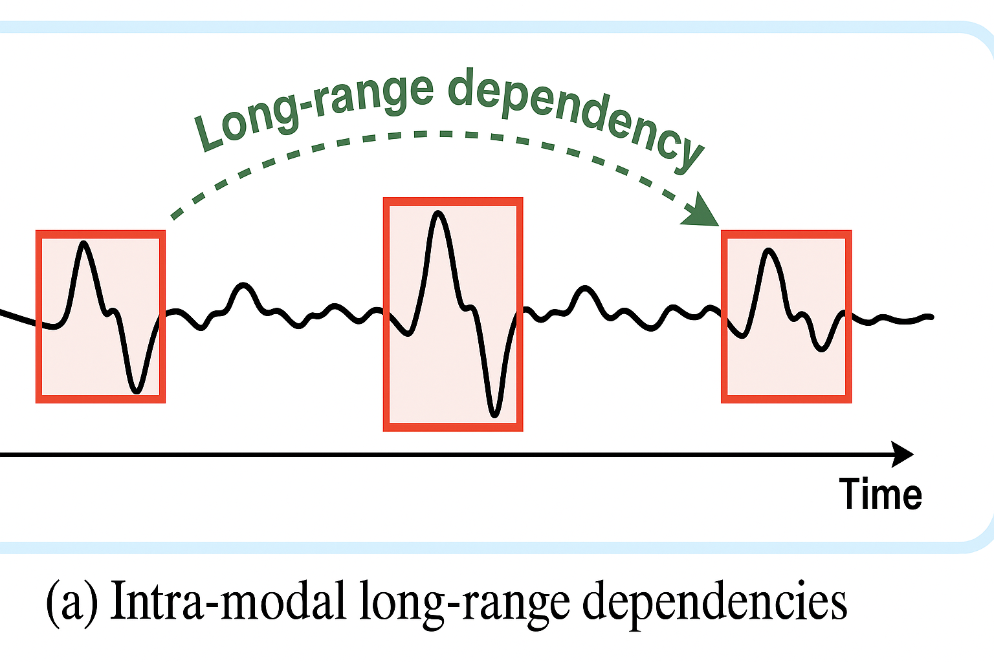
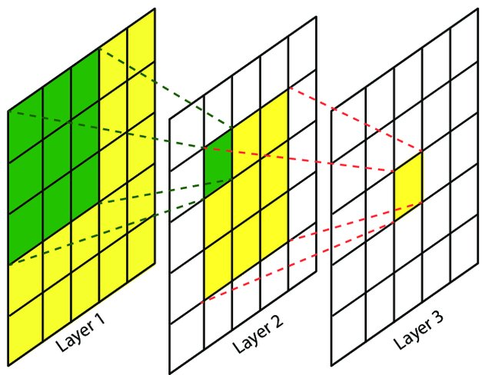
Motivation & Challenge
C1: How to effectively model both the intra-modal long-range dependencies and inter-modal correlations of physiological signals.
· C1.1: The intra-modal long-range dependencies:
Physiological signals exhibit long-range dependencies reflecting the gradual accumulation of emotional changes.
CNN-based networks struggle to capture essential long-range temporal information.
Transformer-based networks lacks an explicit temporal-filtering capability.
NeurIPS 2025
Notes:
Although multimodal physiological methods for emotion recognition have achieved significant progress, there are still two challenges. Challenge one: How to effectively model both the intra-modal long-range dependencies and inter-modal correlations of multimodal emotion-related physiological signals.
For the intra-modal long-range dependencies, as a typical form of time-series data, emotion-related physiological signals exhibit long-range dependencies reflecting the gradual accumulation of emotional changes. Emotions, such as anxiety, develop progressively and require a duration for their physiological manifestations to accumulate. Such accumulation underscores that emotional changes are not just a state that occurs instantaneously but a process that evolves.
CNN-based networks excel at extracting local features but struggle to capture essential long-range temporal information. Although stacking more convolutional layers together with pooling operations to expand the receptive field can theoretically increase context, it often degrades fine-grained local details. What’s more, Transformer-based networks are able to capture global emotional patterns, but their attention mechanism lacks explicit temporal filtering capability and tends to distribute weight uniformly across all time steps. This makes it difficult for these methods to construct practical long-range dependencies based on key nodes of emotion fluctuations.
尽管多模态生理信号在情感识别领域已取得显著进展，但仍面临两大挑战。首要挑战在于如何有效建模多模态情感相关生理信号的模态内长程依赖关系与模态间关联性。作为典型时间序列数据，情感相关生理信号的长程依赖性体现了情绪变化的渐进累积特性。例如焦虑情绪会逐步发展，其生理表现需要一定时间积累才能显现。这种累积过程表明，情绪变化并非瞬时状态，而是持续演变的过程。基于卷积神经网络的模型擅长提取局部特征，却难以捕捉关键的长程时间信息。虽然通过堆叠更多卷积层并结合池化操作来扩展感受野理论上可增强上下文信息，但往往会导致局部细节的精细度下降。此外，基于Transformer的模型虽能捕捉全局情绪模式，但其注意力机制缺乏明确的时间过滤能力，且倾向于将权重均匀分配到所有时间步。这使得这些方法难以基于情绪波动的关键节点构建实用的长程依赖关系。

Slide 5

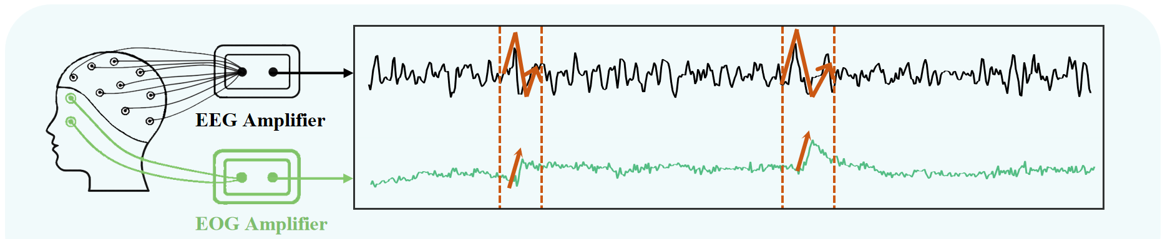
Motivation & Challenge
C1: How to effectively model both the intra-modal long-range dependencies and inter-modal correlations of physiological signals.
· C1.2: The inter-modal correlations:
The inter-modal correlations are evident in the way different modalities respond.
Transformer-based networks cannot be fully captured through pairwise channel-wise interactions, making it difficult to model high-order correlations.This limitation essentially stems from the lack of explicit global state variables in the attention mechanism.
NeurIPS 2025
Notes:
For the inter-modal correlations, the inter-modal correlations are evident in the way different modalities respond.
The token-level attention in Transformer-based networks only computes pairwise relationships between channels and maintains only instantaneous interaction states. However, the complex dependencies inherent in physiological signals cannot be fully captured through pairwise channel-wise interactions, making it difficult to model high-order correlations. This limitation essentially stems from the lack of explicit global state variables in the attention mechanism, which hinders the effective integration of cross-modal information. Therefore, how to effectively model the intra-modal long-range dependencies and inter-modal correlations of multimodal physiological signals remains a significant challenge.
在跨模态相关性研究中，不同模态间的响应方式具有显著特征。基于Transformer的网络采用标记级注意力机制，仅计算通道间的成对关系，仅保留瞬时交互状态。然而，生理信号固有的复杂依赖关系无法通过通道间的成对交互完全捕捉，这使得高阶相关性建模变得困难。这种局限性本质上源于注意力机制中缺乏显式的全局状态变量，阻碍了跨模态信息的有效整合。因此，如何有效建模多模态生理信号的模态内长程依赖关系和跨模态相关性，仍是当前研究面临的重要挑战。

Slide 6
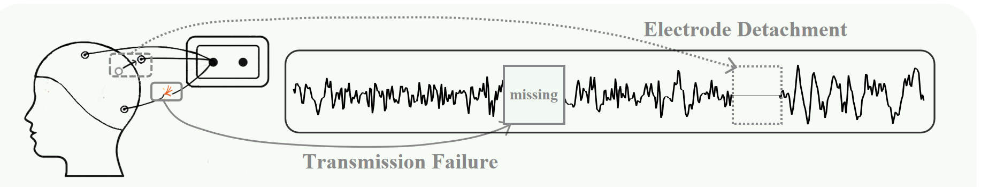
Motivation & Challenge
C2: How to mitigate the impact of missing multimodal emotion-related physiological data on model.
· Multimodal missing data:
When acquiring emotion-related physiological signals, uncontrollable factors may cause sensors to slip or experience poor contact, resulting in incomplete multimodal signal acquisition to varying degrees.
The unavoidable presence of missing data amplify the distribution shifts in physiological data.
NeurIPS 2025
Notes:
When acquiring emotion-related physiological signals, subjects must remain seated for extended periods while exposed to high-intensity stimuli to generate emotional responses. However, uncontrollable factors such as perspiration, changes in posture, or the drying of the conductive gel may cause sensors to slip or experience poor contact, resulting in incomplete multimodal signal acquisition to varying degrees. Such incompleteness amplifies the distribution shifts in emotion-related physiological data, ultimately leading to degraded model performance. First, emotion-related physiological data inherently exhibit distribution shifts between the training and test sets. These shifts arise from within-subject variations in emotional state, cognitive load, and environmental conditions across sessions. Furthermore, the unavoidable presence of missing data disrupts the original data patterns, skews feature distributions, and introduces bias, which collectively amplify the existing distribution shifts in physiological data. This amplification makes it increasingly challenging for pre-trained models to capture emotional patterns accurately.
在采集情绪相关生理信号时，受试者需要长时间保持坐姿并暴露于高强度刺激以产生情绪反应。然而，诸如出汗、姿势变化或导电凝胶干燥等不可控因素可能导致传感器滑脱或接触不良，从而不同程度地造成多模态信号采集不完整。这种不完整性会加剧情绪相关生理数据的分布偏移，最终导致模型性能下降。首先，情绪相关生理数据在训练集和测试集之间本身就存在分布偏移。这些偏移源于受试者在不同实验环节间的情绪状态、认知负荷和环境条件的个体差异。此外，不可避免的缺失数据会破坏原始数据模式，扭曲特征分布并引入偏差，这些因素共同放大了生理数据中本就存在的分布偏移。这种放大效应使得预训练模型越来越难以准确捕捉情绪模式。
Existing methods focus on training phase measures to deal with the missing data problem. For example, Salazar et al. propose feature- and decision-level fusion methods to address the data missingness issue in multimodal emotion recognition. However, these methods typically require retraining to adapt to new missing data patterns, limiting their application flexibility. Furthermore, a promising approach is to mitigate the effects of missing data by fine-tuning the model during the testing phase. For instance, Yang et al., Lei and Pernkopf address unimodal corruption in multimodal data by adjusting self-attention modules to assign lower weights to the corrupted modality. However, these methods cannot handle cases of multimodal corruption where multiple physiological signals are simultaneously missing. Therefore, mitigating the negative impact of missing multimodal data on emotion recognition models remains a significant challenge in practical applications.

Slide 7
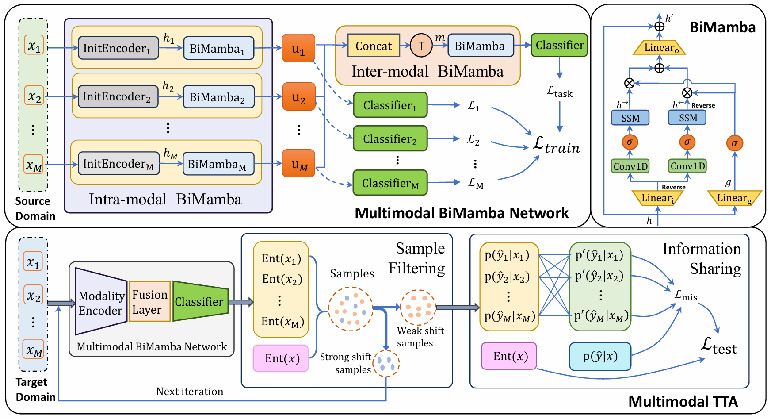
Methods
BiM-TTA: A Multimodal BiMamba Network with Test-TimeAdaptation
Contribution:
Multimodal BiMamba network for long-range dependencies within modalities and inter-modal correlations
Multimodal TTA to alleviate the negative impact of amplified distribution shifts caused by missing multimodal data on model performance
SOTA performance on two multimodal emotion datasets
NeurIPS 2025
Notes:
Overall, the key contributions of this study can be summarised as follows:
• We design a multimodal BiMamba network, where the intra-modal BiMamba module models long-range dependencies within modalities, and the inter-modal BiMamba module captures inter-modal correlations.
• We propose a multimodal TTA method that alleviates the negative impact of amplified distribution shifts caused by missing multimodal data on model performance.
• The evaluation of BiM-TTA on two multimodal emotion datasets confirms its state-of-the-art performance and effectiveness.

Slide 8
Methods
C1: How to effectively model both the intra-modal long-range dependencies and inter-modal correlations of physiological signals.
· C1.1: The intra-modal long-range dependencies.
· C1.2: The inter-modal correlations.
S1: We design a multimodal BiMamba network, where the intra-modal BiMamba module models long-range dependencies within modalities, and the inter-modal BiMamba module captures inter-modal correlations.
· S1.1->C1.1: The intra-modal BiMamba module.
· S1.2->C1.2: The inter-modal BiMamba module.
NeurIPS 2025
Notes:
For challenge one, We design a multimodal BiMamba network. The multimodal BiMamba network consists of two modules: the intra-modal BiMamba module and the inter-modal BiMamba module. The former is designed to model each modality independently, and the latter effectively fuses multimodal features.
针对第一个挑战，我们设计了一个多模态BiMamba网络。该网络由两个模块构成：模态内BiMamba模块和模态间BiMamba模块。前者用于独立建模各模态，后者则有效融合多模态特征。

Slide 9
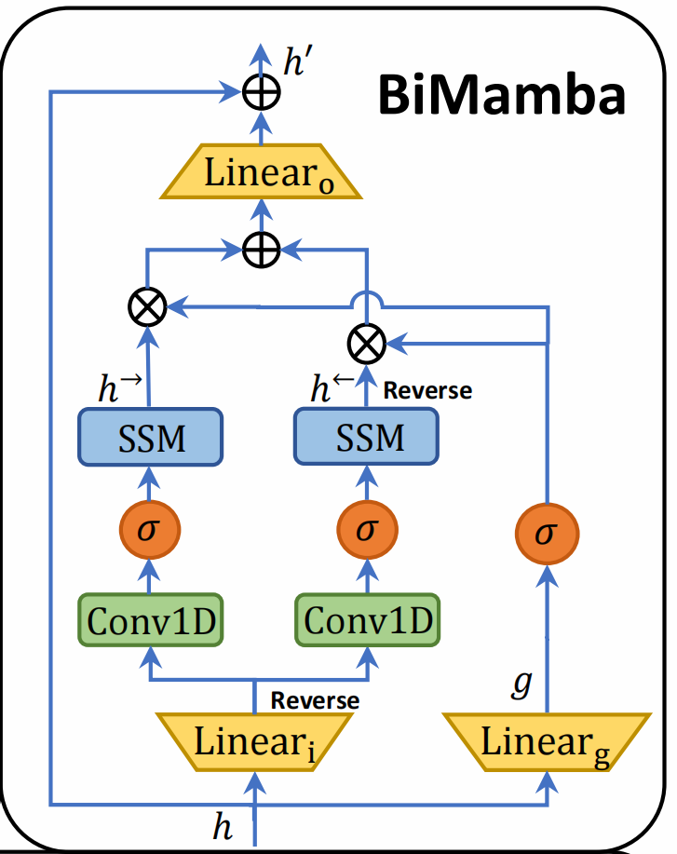
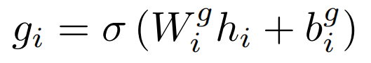
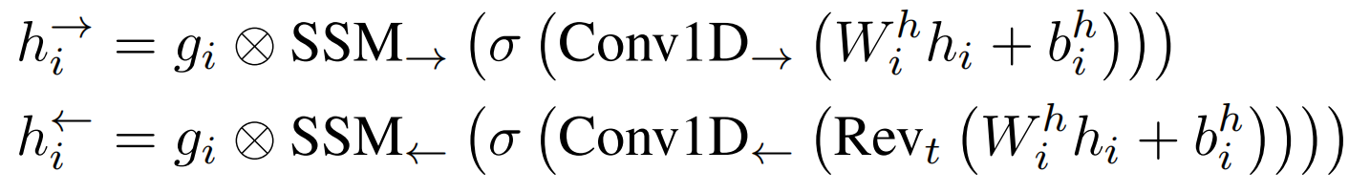
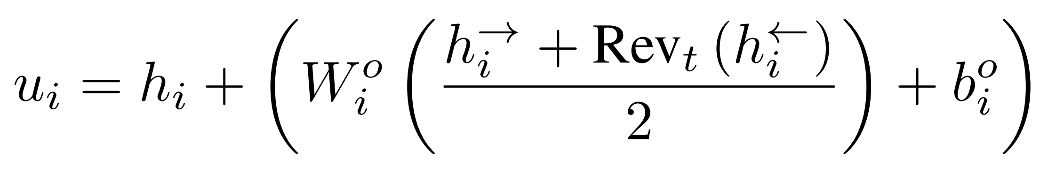
Methods
· BiMamba:
1 Gating mechanism：That adaptively weights features to highlight emotion-relevant information while suppressing noise and redundancy:
3
2 State-space modeling：That models temporal dependencies from both forward and backward perspectives, thereby capturing richer contextual dynamics:
1
2
3 Linear projection and residual connection: Those integrate bidirectional features and stabilize training
NeurIPS 2025
Notes:
Mamba is designed for natural language processing tasks, where its output at each time step depends only on the current input and hidden state, without involving information from future time steps. This unidirectional modeling approach is well suited for generative autoregressive tasks, as these tasks rely primarily on previous information for inference. However, in emotion classification tasks based on physiological signals, it is necessary to capture contextual information from physiological time series simultaneously, and a unidirectional approach cannot fully capture the complex temporal patterns. To address this limitation, we design the intra-modal BiMamba module. This module comprehensively integrates the temporal features of each modality through a selective input mechanism and bidirectional modeling. We first introduce the core module, BiMamba.
It consists of three steps：
First, BiMamba employs a gating mechanism that adaptively weights features to highlight emotion-relevant information while suppressing noise and redundancy.
Second, BiMamba models temporal dependencies from both forward and backward perspectives using state-space modeling, thereby capturing richer contextual dynamics.
Finally, BiMamba applies linear projection and residual connection to integrate bidirectional features and stabilize training.
我们设计了跨模态BiMamba模块。该模块通过选择性输入机制和双向建模，全面整合了各模态的时间特征。首先介绍核心模块BiMamba，其包含三个关键步骤：第一，BiMamba采用门控机制自适应加权特征，既能突出情感相关信息，又能抑制噪声和冗余；第二，通过状态空间建模从正向和反向视角建模时间依赖关系，从而捕捉更丰富的上下文动态；最后，BiMamba运用线性投影和残差连接来整合双向特征并稳定训练过程。

Slide 10
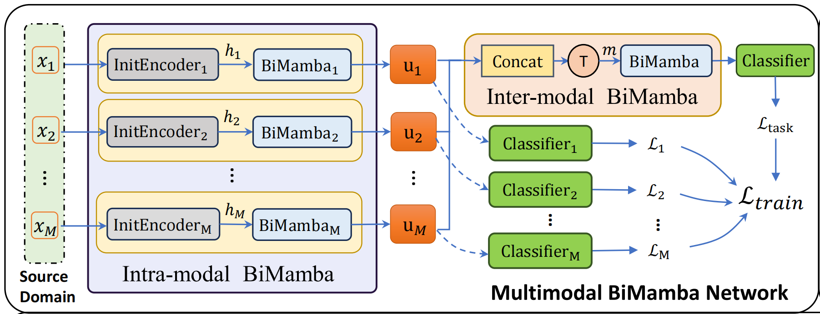
Methods
· S1.1: The intra-modal BiMamba module:
${ InitEncoder}_{i}()$ : Extract shallow features from each modality input from a specific modality.
BiMamba: Model the temporal dimension further.
NeurIPS 2025
Notes:
Based BiMamba, we design the intro-modal BiMamba module. This module comprehensively integrates the temporal features of each modality through a selective input mechanism and bidirectional modeling.
Initially, we design the initial encoder to extract shallow features from a specific modality.
Next, we introduce the BiMamba to model the temporal dimension further.

Slide 11
Methods
· S1.2: The inter-modal correlations:
Concatenate the features of each modality along the channel dimension, and swap the time and channel dimensions.
BiMamba: perform bidirectional state modeling of the features from different modalities along the channel dimension.
NeurIPS 2025
Notes:
In the intra-modal BiMamba module, we focus on state modeling at the unimodal time scale. However, relying solely on intra-modal modeling neglects inter-modal correlations that are crucial for comprehensive multimodal understanding. Hence, we propose the inter-modal BiMamba module for modeling correlations across modalities.
In this module, the features of different modalities are integrated into a unified feature matrix to enable interaction among modalities. The inter-modal BiMamba module then performs bidirectional state modeling to capture dependencies across modalities. In the forward process, information from preceding modalities helps construct the representation of the current modality, while in the backward process, information from subsequent modalities provides complementary context. This bidirectional modeling mechanism captures inter-modal correlations from multiple perspectives, thereby enhancing the representational ability of multimodal features.
在单模态BiMamba模块中，我们专注于单模态时间尺度的状态建模。然而，单纯依赖单模态建模会忽略对全面理解多模态至关重要的跨模态关联。为此，我们提出跨模态BiMamba模块，用于建模不同模态间的关联性。该模块通过将不同模态的特征整合到统一的特征矩阵中，实现模态间的交互作用。跨模态BiMamba模块随后执行双向状态建模，捕捉跨模态间的依赖关系。在前向过程中，先前模态的信息有助于构建当前模态的表征；在后向过程中，后续模态的信息提供互补上下文。这种双向建模机制从多维度捕捉跨模态关联，从而提升多模态特征的表征能力。

Slide 12
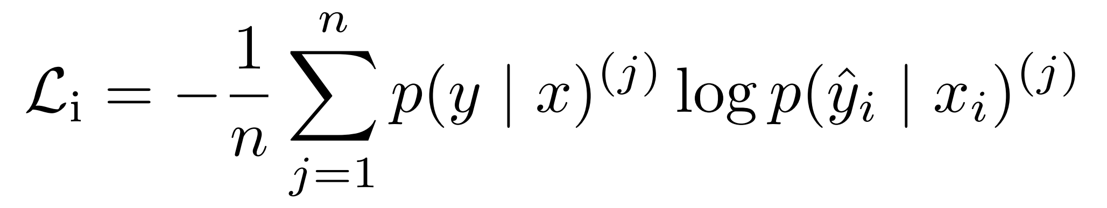
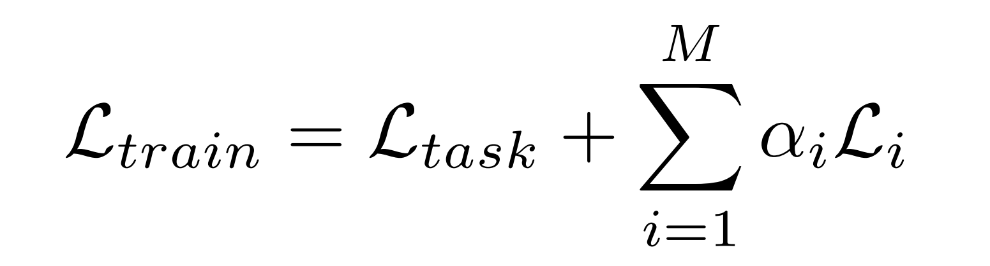
Methods
· Auxiliary task:
The cross-entropy loss for each modality is computed as:
The overall training objective is defined as:
NeurIPS 2025
Notes:
To effectively learn the optimal states of each modality encoder during training, while balancing the training progress across modalities and preventing overfitting in any single modality, we further design an auxiliary task. After independently modeling the unique feature representations of each modality through the intra-modal BiMamba module, an additional classifier is introduced to generate unimodal prediction probabilities.
The cross-entropy loss for each modality is computed as:
The overall training objective is defined as:
This auxiliary task enables each modality to learn more discriminative representations by encouraging modality-specific supervision. During training, the overall objective jointly optimizes the main classification loss and the auxiliary losses from all modalities, ensuring balanced learning and improved generalization across different modalities.
为了在训练过程中有效学习各模态编码器的最优状态，同时平衡不同模态的训练进度并防止单一模态过拟合，我们进一步设计了一个辅助任务。在通过模态内BiMamba模块独立建模各模态的独特特征表示后，引入额外分类器生成单模态预测概率。各模态的交叉熵损失计算公式为：整体训练目标定义为：该辅助任务通过鼓励模态特定监督，使各模态能够学习更具区分性的表征。在训练过程中，整体目标会联合优化主分类损失和所有模态的辅助损失，确保学习过程均衡且不同模态间泛化能力提升。

Slide 13
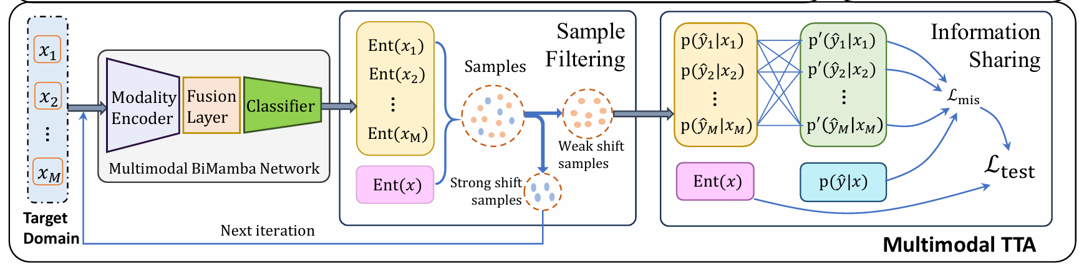
Methods
C2: How to mitigate the impact of missing multimodal emotion-related physiological data on model.
S2: We propose the multimodal TTA method consisting of two key steps:
1）two-level entropy-based sample filtering
2）mutual information sharing across modalities.
NeurIPS 2025
Notes:
For challenge two, we propose the multimodal TTA method, which consists of two key steps: two-level entropy-based sample filtering and mutual information sharing across modalities.
针对第二个挑战，我们提出了一种多模态TTA方法，该方法包含两个关键步骤：基于熵的双级样本过滤和跨模态互信息共享。

Slide 14
Methods
· Step1: Two-level entropy-based sample filtering
Selectively retains samples with low multimodal entropy and high unimodal entropy.
Low：more reliable, which often corresponds to a closer distribution.
multimodal entropy
High：greater uncertainty, which often corresponds to strong distribution shifts.
Low：the sample contains limited multimodal information.
unimodal entropy
High：the sample possesses richer multimodal information.
Next, we employ an iterative entropy-based sample selection strategy to progressively expand the range of target-domain samples.
NeurIPS 2025
Notes:
Step1: Two-level entropy-based sample filtering
Missing multimodal data affects samples differently, with a small subset suffering severe degradation of multimodal information due to the loss of key emotional cues. Directly using such samples for fine-tuning often harms model performance. To address this, we propose a two-level entropy-based sample filtering method:
(a) Multimodal entropy reflects the model's certainty about its prediction. A lower value suggests that the prediction is more reliable, which often corresponds to a distribution in the target domain closer to that in the source domain. Using such samples for fine-tuning leads to a more stable and reliable model adaptation. Conversely, a higher value indicates greater uncertainty, which often corresponds to strong distribution shifts from the source domain, making these samples unsuitable for fine-tuning.
(b) Unimodal entropy measures the extent to which a sample relies on multimodal information. A lower value indicates that the prediction can be made primarily based on a single dominant modality, suggesting that the sample contains limited multimodal information. In contrast, a higher value implies that the prediction is more likely to integrate multiple modalities, indicating that the sample possesses richer multimodal information and is more suitable for fine-tuning.
Therefore, we design a method that selectively retains samples with low multimodal entropy and high unimodal entropy. These samples are more conducive to stable model adaptation and contain richer multimodal information.
Next, we employ an iterative entropy-based sample selection strategy to progressively expand the range of target-domain samples.
步骤1：基于双层熵的样本筛选机制缺失的多模态数据对样本的影响各不相同，其中小部分样本因关键情感线索丢失而遭受严重信息退化。直接使用这类样本进行微调往往会影响模型性能。为此，我们提出了一种基于双层熵的样本筛选方法：(a)多模态熵反映模型对预测结果的确定性。较低的值表明预测更可靠，通常对应目标域分布与源域分布更接近的情况。使用这类样本进行微调能获得更稳定可靠的模型适应效果。反之，较高的值则表示存在较大不确定性，通常对应源域分布的显著偏移，这类样本不适合用于微调。(b)单模态熵衡量样本对多模态信息的依赖程度。较低的值表明预测主要基于单一主导模态，说明样本包含的多模态信息有限。相反，较高的值意味着预测更可能整合多种模态，表明样本具有更丰富的多模态信息，更适合用于微调。因此，我们设计了一种筛选方法，选择性保留多模态熵较低而单模态熵较高的样本。这些样本更有利于模型的稳定适应，并且包含更丰富的多模态信息。接下来，我们采用迭代熵采样策略，逐步扩大目标域样本的覆盖范围。

Slide 15
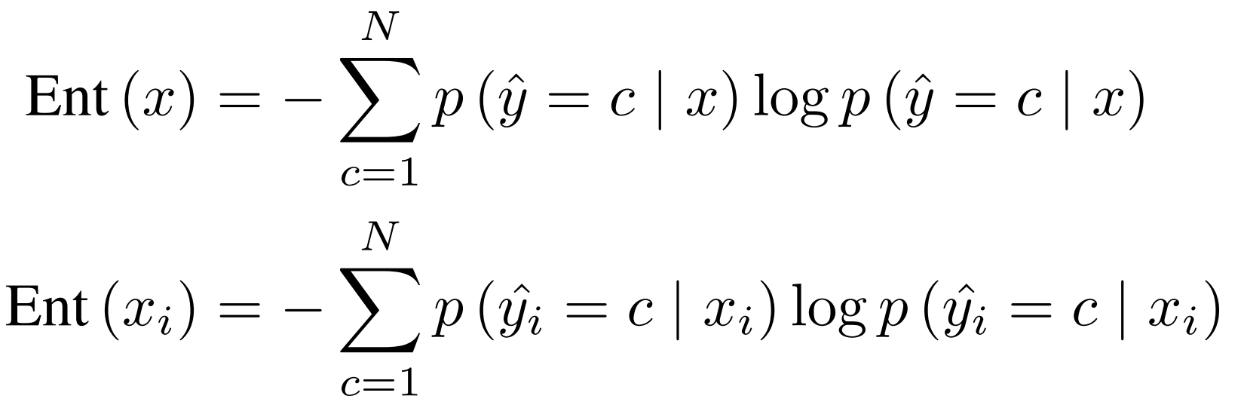
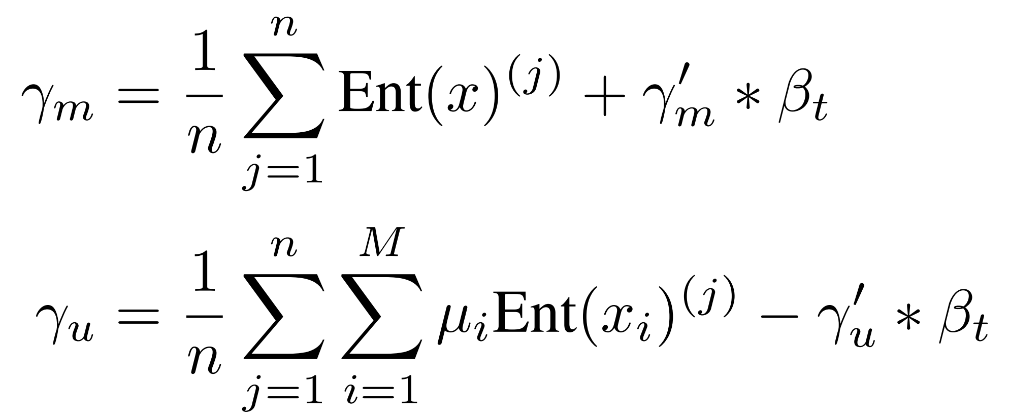
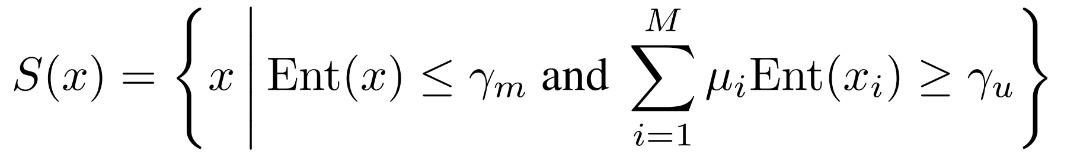
Methods
· Step1: Two-level entropy-based sample filtering
First, we compute the multimodal entropy and unimodal entropy of each sample.
Next, a gradually increasing threshold is used to ensure a smooth adaptation. The thresholds are defined as:
Finally, the filtering employs the following identification criteria.
NeurIPS 2025
Notes:
In details, first, we compute the multimodal entropy and unimodal entropy of each sample.
Next, we employ an iterative entropy-based sample selection strategy to progressively expand the range of target-domain samples. During this process, the model first adapts to samples with weak distribution shifts and rich multimodal information. As the iterations progress, it gradually incorporates samples with strong distribution shifts to achieve smooth adaptation from the source domain to the target domain. Specifically, a gradually increasing threshold is used to ensure a smooth adaptation. The thresholds are defined as:
Finally, the filtering employs the following identification criteria:
具体而言，首先计算每个样本的多模态熵和单模态熵。接着采用基于熵的迭代样本选择策略，逐步扩大目标域样本范围。在此过程中，模型首先适应分布偏移较弱且多模态信息丰富的样本。随着迭代推进，模型会逐步纳入分布偏移显著的样本，从而实现从源域到目标域的平滑迁移。具体而言，通过采用逐步递增的阈值来确保适应过程的平滑性。这些阈值定义如下：最后，过滤环节采用以下识别标准：

Slide 16
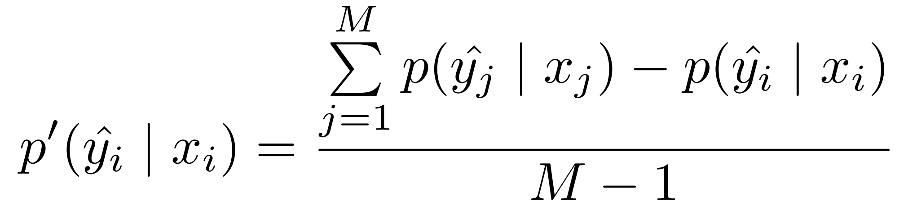
Methods
· Step2: Mutual information sharing across modalities
Mutual information sharing across modalities leverages more informative modalities to guide those with significant missing information, alleviating amplified inter-modal distribution shifts.
Specifically, we define the complementary probability of the prediction probability of the i-th modality as:
NeurIPS 2025
Notes:
Step2: Mutual information sharing across modalities
Mutual information sharing across modalities uses the more informative modalities to guide the learning of modalities with significant missing information. This alleviates the impact of amplified distribution shifts between modalities, thereby mitigating the negative effects of amplified overall distribution shifts in the target domain.
Specifically, we define the complementary probability of the prediction probability of each modality as:
第二步：跨模态互信息共享。该方法通过利用信息量更大的模态来指导信息缺失严重的模态学习，从而缓解模态间分布偏移的放大效应，进而降低目标领域整体分布偏移的负面影响。具体而言，我们定义各模态预测概率的互补概率为：

Slide 17
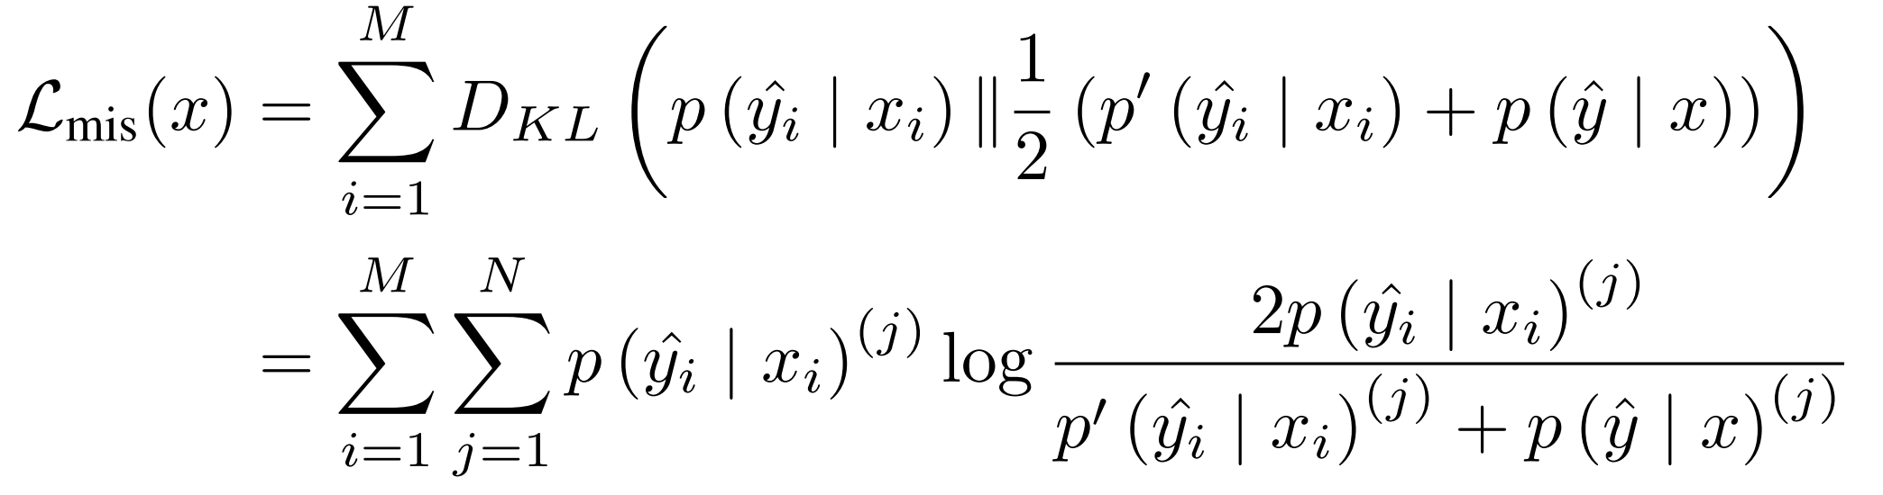
Methods
· Step2: Mutual information sharing across modalities
To improve the consistency of predictions across different modalities, we can minimize the KL divergence between the probability and its complementary probability.
However, if a modality is severely corrupted, minimizing the KL divergence may negatively impact the informative modalities. Therefore, we also include the multimodal probability to improve stability and reliability. The mutual information sharing loss across modalities is defined as:
NeurIPS 2025
Notes:
To improve the consistency of predictions across different modalities, we can minimize the KL divergence between the probability of each modality and its complementary probability. However, if a modality is severely corrupted, minimizing the KL divergence may negatively impact the informative modalities. Therefore, we also include the multimodal probability to improve stability and reliability. The mutual information sharing loss across modalities is defined as:
Through mutual information sharing across modalities, the model can effectively align information between different modalities. When some modalities perform poorly, other modalities can provide valuable information, enhancing the overall prediction performance.
为提升跨模态预测的一致性，我们可以通过最小化各模态概率与其互补概率之间的KL散度来实现。但若某模态严重受损，这种最小化操作可能对信息丰富的模态产生负面影响。为此，我们还引入了多模态概率以增强模型的稳定性和可靠性。跨模态互信息共享损失的定义为：通过跨模态互信息共享，模型能有效整合不同模态间的信息。当某些模态表现欠佳时，其他模态可提供关键信息，从而提升整体预测性能。

Slide 18
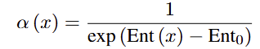
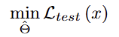
Methods
· TTA optimization
Loss computation: We use weighted terms to emphasize the contribution of samples during the adaptation process. The weight term and the final loss are defined as:
Fine-tuning details: only the parameters of the first convolutional layer in the initial encoder, the first fully connected layer of the inter-modal BiMamba module, and all batch normalization layers are fine-tuned.
NeurIPS 2025
Notes:
Regarding the TTA optimization, we focus on two aspects: loss computation and fine-tuning details.
Loss Computation We use weighted terms to emphasize the contribution of samples during the adaptation process. The weight term is defined as:
Based on the weighted term, the final loss is formulated as:
Fine-Tuning Details Inspired by surgical fine-tuning, only the parameters of the first convolutional layer in the initial encoder, the first fully connected layer of the inter-modal BiMamba module, and all batch normalization layers are fine-tuned. This selective fine-tuning strategy effectively reduces computational overhead while maintaining the stability of the model’s essential component. Finally, the objective function for multimodal TTA is defined as:
在TTA优化方面，我们重点关注两个维度：损失函数计算与微调细节。损失函数计算我们采用加权项来强化样本在自适应过程中的贡献度。加权项定义为：基于该加权项，最终损失函数可表示为：微调细节受外科手术式精细调整启发，我们仅对初始编码器的第一卷积层参数、跨模态BiMamba模块的第一个全连接层参数，以及所有批量归一化层参数进行微调。这种选择性微调策略在保持模型核心组件稳定性的同时，有效降低了计算开销。最终，多模态TTA的目标函数定义为：

Slide 19
Experiments
Datasets:
DEAP
32 participants, 40 one-minute music video trials each.
EEG: 32-channel BioSemi (10–20 system) + 8 peripheral signals (respiration, EOG, EMG).
Signals resampled to 128 Hz, EEG filtered (4–45 Hz), ocular artifacts removed.
Arousal & valence rated 1–9; threshold = 5 for high/low emotion.
MAHNOB-HCI
30 subjects, 20 video trials with self-reported 1–9 ratings (final 27 subjects used).
EEG: 32-channel BioSemi Active II + 6 peripheral signals (ECG, GSR, respiration, temperature, etc.).
Original 256 Hz sampling rate retained.
Arousal & valence rated 1–9; threshold = 5 for high/low emotion.
NeurIPS 2025
Notes:
1) The DEAP dataset: It involves 32 participants, each completing 40 one-minute trials based on music videos. In the experiment, EEG is recorded with a BioSemi 32-channel cap following the international 10–20 system, while 8 additional channels capture peripheral physiological signals including respiration rate, EOG, and EMG. After each video, participants provide self-assessments of arousal, valence, liking, dominance, and familiarity. During preprocessing, all signals are resampled to 128 Hz. The EEG is bandpass filtered between 4 and 45 Hz, and ocular artifacts are removed.Arousal and valence are rated on a scale from 1 to 9. A threshold of 5 is used to distinguish low and high emotional classes.
2) The MAHNOB-HCI dataset: It includes 30 subjects, each completing 20 video-based trials with self-reported ratings from 1 to 9. In the experiment, EEG signals are recorded using the BioSemi Active II system equipped with 32 Ag/AgCl electrodes, while six peripheral physiological signals are simultaneously recorded. These peripheral physiological signals include ECG, GSR, respiration, and body temperature. To maintain consistency across modalities, all recordings are kept at their original sampling rate of 256 Hz. A fixed threshold of 5 is applied to discretize the continuous arousal and valence ratings into binary categories. As the recordings of subjects 12, 15, and 26 are unavailable, the final analysis is conducted on 27 subjects, consistent with previous studies such as TSCeption and HetEmotionNet.

Slide 20
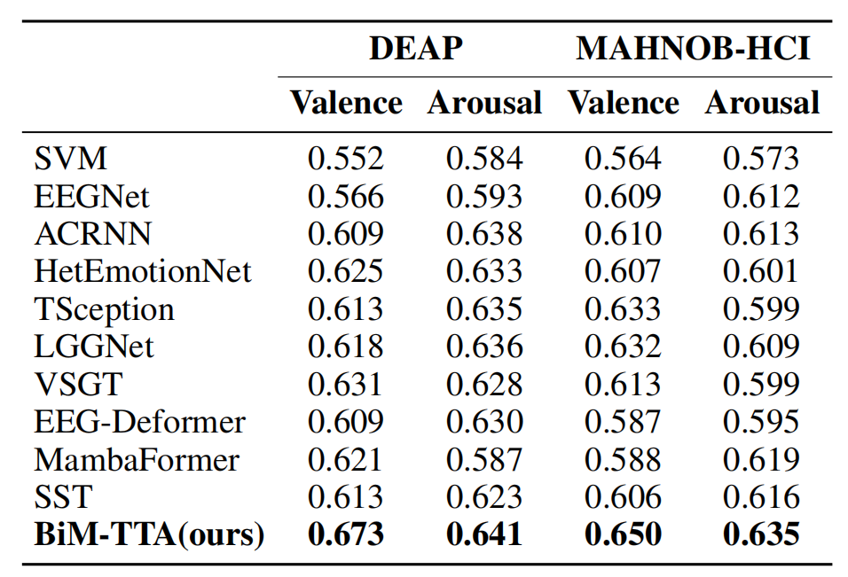
Experiments
Comparison with Emotion recognition models:
Traditional machine learning methods
CNN-based and unidirectional
RNN-based models
GNN-based models
Transformer/Transformer+SSM models
SOTA
NeurIPS 2025
Notes:
For experiments without missing data, as shown in Table, deep learning methods generally outperform SVM. EEGNet and TSception primarily use CNNs to extract intra-modal temporal features. ACRNN combines CNNs and unidirectional LSTM to model temporal features, and HetEmotionNet uses unidirectional GRU to model the time dimension. However, these CNN-based and unidirectional RNN-based models have limitations in capturing long-range dependencies within the modality. VSGT and LGGNet model the inter-channel relationships using GNNs, yet their temporal modeling relies solely on CNNs and fully connected layers, which hampers the capture of complex long-range dependencies. Furthermore, EEG-Deformer combines CNNs and Transformers to extract complex temporal features. MambaFormer embeds Mamba modules into Transformer feed-forward layers to unify long- and short-range modeling, and SST couples a Mamba-based global expert with a windowed Transformer local expert and fuses their outputs. Although these hybrid models strengthen temporal dependency modeling, they still overlook inter-channel interactions, as they rely on simplified fusion strategies such as single-layer convolutions or linear projections, which constrain their capacity to capture complex inter-modal relationships. In contrast, BiM-TTA models long-range dependencies within modalities and correlations between modalities through the intra-modal BiMamba module and inter-modal BiMamba module. It achieves the best performance on both datasets, demonstrating the superiority of the multimodal BiMamba backbone network.

Slide 21
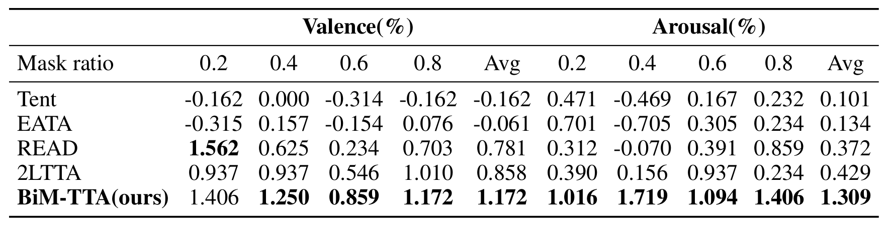
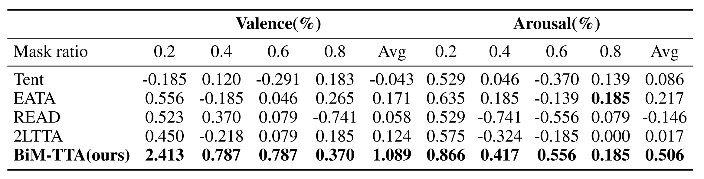
Experiments
Comparison with TTA methods:
DEAP
Other TTA methods
MAHNOB-HCI
SOTA
NeurIPS 2025
Notes:
For experiments with missing data, the two tables present the performance improvements of BiM-TTA and other TTA methods relative to the ``No Adapt'' method. ``No Adapt'' denotes a model trained on the source domain and subsequently evaluated on the target domain containing missing data, without any adaptation. Tent improves model performance on the target domain by minimizing predictive entropy. READ fine-tunes the self-attention fusion layer to adjust inter-modal weights, alleviating the impact of information disparity across different modalities. 2LTTA employs a two-level objective function that includes entropy-based sample reweighting and diversity-promoting loss. However, they indiscriminately adapt the model to all samples with missing data at once, which may result in significant parameter adjustments to fit the target domain, thereby reducing overall performance. Moreover, EATA selectively adapts to reliable samples. However, it does not account for the varying levels of degradation across different modalities and thus does not fully integrate the useful complementary information between modalities. In contrast, our method uses two-level entropy-based sample filtering to avoid the model directly adapting to samples with strong distribution shifts and limited multimodal information. Furthermore, we utilize inter-modal information sharing to align the information between different modalities, facilitating the full adaptation of the model.

Slide 22
Conclusion
Contribution:
This paper proposes a multimodal BiMamba network with TTA for emotion recognition.
The multimodal BiMamba network effectively captures intra-modal dependencies and inter-modal correlations of multimodal physiological signals.
The TTA consisting of two-level entropy-based sample filtering and mutual information sharing across modalities alleviates the negative impact of amplified distribution shifts caused by missing multimodal data. Experiment results demonstrate that our model achieves state-of-the-art performance.
Prospect:
We will further extend BiM-TTA to broader physiological analysis tasks, including sleep stage classification and motor imagery.
NeurIPS 2025
Notes:
This paper proposes a multimodal BiMamba network with TTA for emotion recognition. In the training phase, the multimodal BiMamba network effectively captures intra-modal dependencies and inter-modal correlations of multimodal physiological signals. The two-level entropy-based sample filtering and mutual information sharing across modalities achieve smooth adaptation to the target domain and reduce distribution shifts across modalities, thereby alleviating the negative impact of amplified distribution shifts caused by missing multimodal data. Experiment results demonstrate that our model achieves state-of-the-art performance. Moreover, the ablation studies further confirm the contribution of each component within BiM-TTA. In summary, we design a general multimodal backbone that incorporates a multimodal TTA mechanism. We will further extend BiM-TTA to broader physiological analysis tasks, including sleep stage classification and motor imagery.

Slide 23
Thanks!
Notes:
结束
Thanks for your listening.

